Slide 1
MSU-Marawi enrolment monitoring mobile application
Joseph C. Sieras

Slide 2
Student enrollment monitoring mobile application
designed to cater the needs of students which is to monitor the enrolled subjects and its statement of account during the enrollment in the MSU-Marawi City.

Slide 3
network architecture

Slide 4
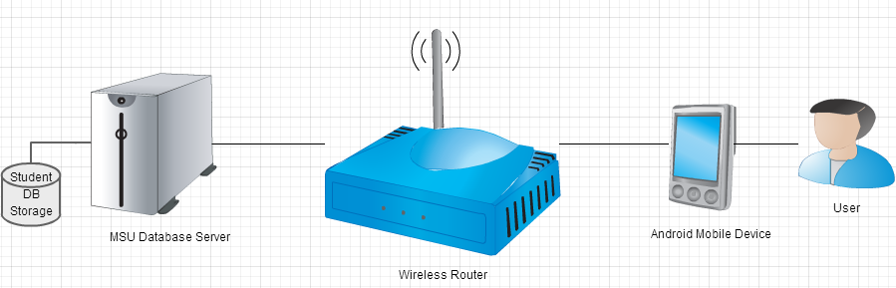
The network architecture of this mobile application is N-tier client–server architecture specifically the thin-Client Wireless Client–Server. The enrolment monitoring mobile application will be installed in an android mobile device and connected to a router through wireless connection. The wireless router is then connected to MSU database server where the student’s profiles can be accessed.

Slide 5
User story

Slide 6
As a student, I want to monitor my computerized preliminary registration form, view my statement of account and certificate of registration through my mobile phone so that i will not fall in line to a long queue of students’ line to just do the inquiry of my enrolled subjects, statement of account and certificate of registration.

Slide 7
USE CASES

Slide 8
Minimum Learning Hours: 10 Hours

Slide 9
Minimum Learning Hours: 4 Hours

Slide 10
Minimum Learning Hours: 4 Hours

Slide 11
Minimum Learning Hours: 2 Hours

Slide 12
Minimum Learning Hours: 4 Hours

Slide 13
Minimum Learning Hours: 2 Hours

Slide 14
Minimum Learning Hours: 5 Hours

Slide 15
Minimum Learning Hours: 15 Hours

Slide 16
Minimum Learning Hours: 10 Hours

Slide 17
Minimum Learning Hours: 10 Hours

Slide 18
Minimum Learning Hours: 15 Hours

Slide 19
Minimum Learning Hours: 10 Hours

Slide 20
Minimum Learning Hours: 10 Hours

Slide 21
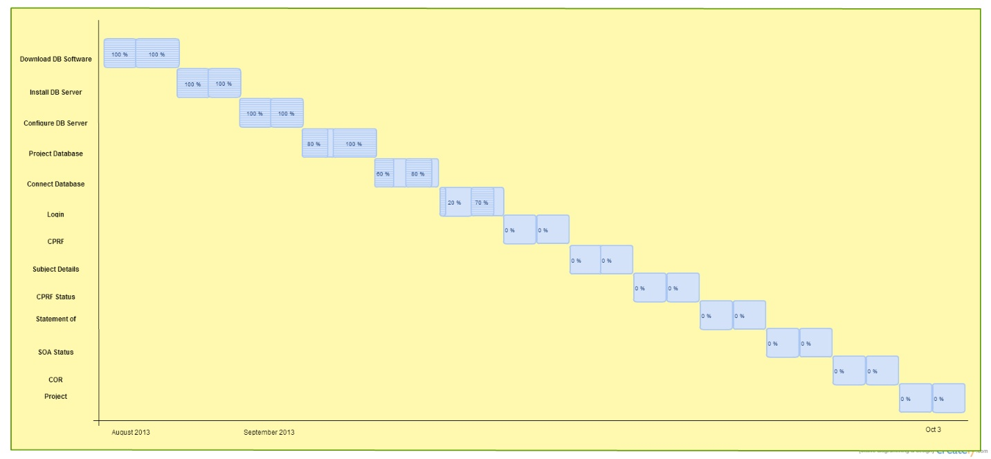

Slide 23
Test case

